Slide 1
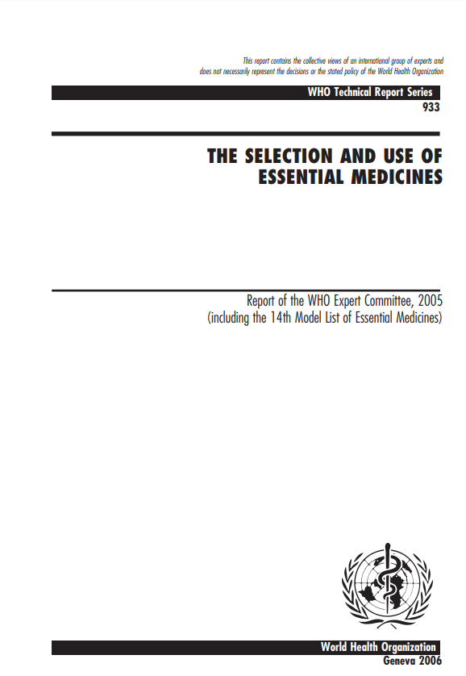
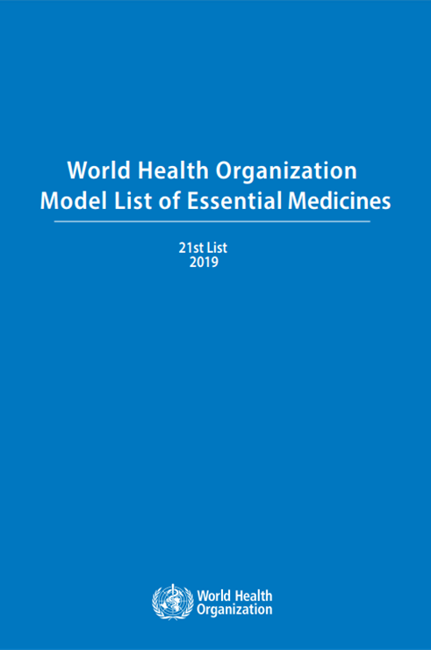
Evolving Evidence & Recommendations on Medical Abortion in WHO documents
1st Abortion Guideline
MA recommended as an option
Essential Medicine List
Mifepristone and misoprostol moved to “core” list
Requirement for close medical supervision removed
consolidated guideline
Updated recommendations on medical abortion including who and how
Essential Medicine List
2nd Abortion Guideline
Task sharing guideline
Medical Abortion Guideline
MA recommended across pregnancy duration
Mifepristone & Misoprostol enters EML. But only on complementary (supplemental) list; under close supervision.
MA at primary care; wide range of providers; out of facility use
“Self” as an active actor in process.
Further simplifications in service provision
2005
2015
2019
2021 (forthcoming)
2003
2012
2018
2020
Source: Ganatra B; Briefing on Medical Abortion to UN Treaty Monitoring Bodies, March 2021; do not reproduce without permission

